Slide 1
Creating a Spotify playlist using K-Means clustering
Tejal Sungra, tejalsungra@gmail.com
Shavi, skambojkhera@gmail.com
Shravanti , shrav1708@gmail.com
René Wollny, wollny.rene@gmail.com

Slide 2

Task
Create playlist(s) out of 5000 songs using K-Means clustering
Explore different data scaling models

Slide 3
Procedure
Clean data set (drop unused columns, remove outliers, clean column names)
Use different scaling methods (MinMax-, Standard-, Robust-Scaler)
Use “Elbow-Method” to define amount of clusters (=playlists)
Use Silhouette score to decide on best scaler
Check different song-features for each cluster to name playlists

Slide 4
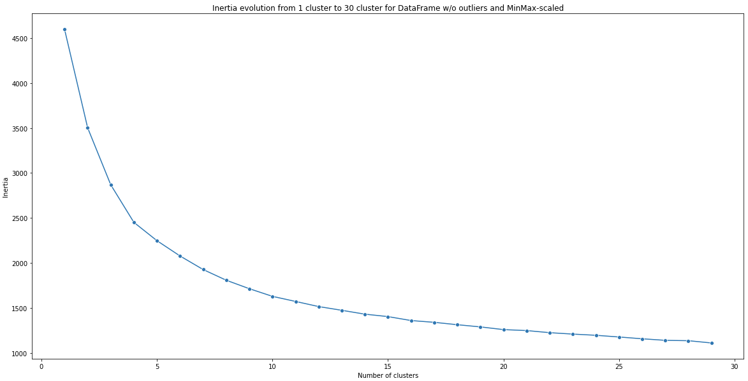
Selecting the number of clusters using the “Elbow-Method”
At 5 clusters, it’s the “elbow”

Slide 5
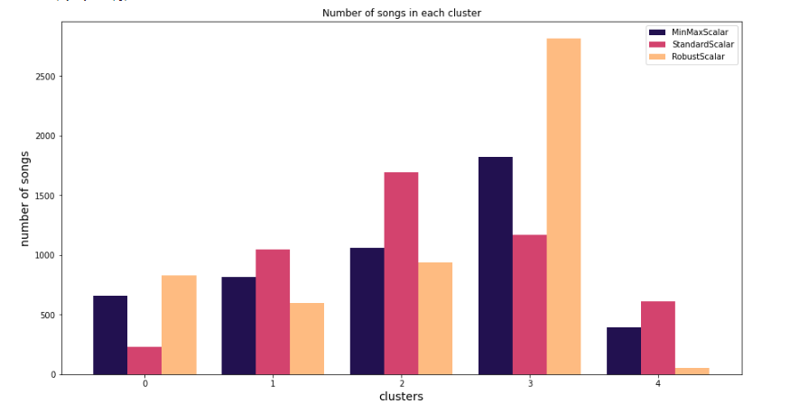
Data scaling models
1. MinMaxScaler
Silhouette score : 0.25
2. StandardScaler
Silhouette score : 0.15
3. Robust Scaler
Silhouette score : 0.20

Slide 6
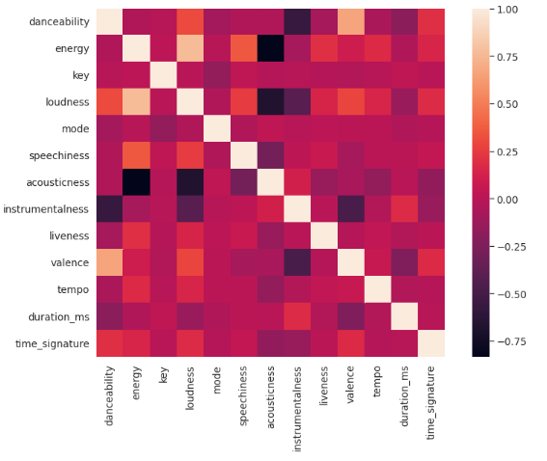
Correlation between different song-features

Slide 7
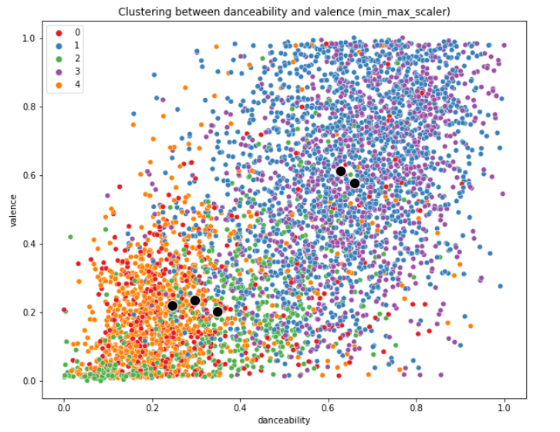
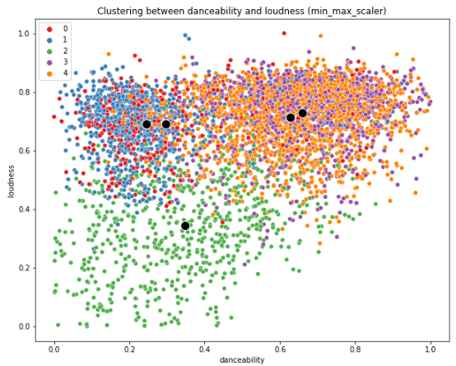
Correlation between danceability and other features

Slide 8
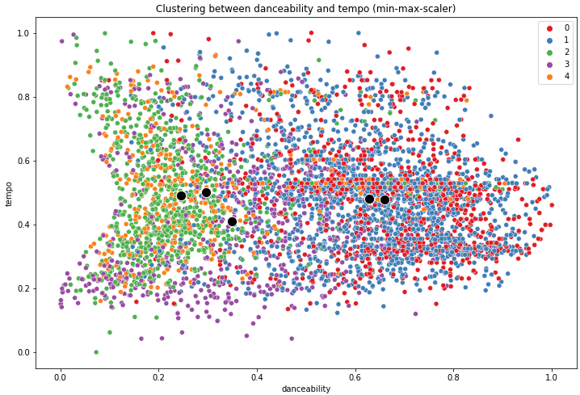
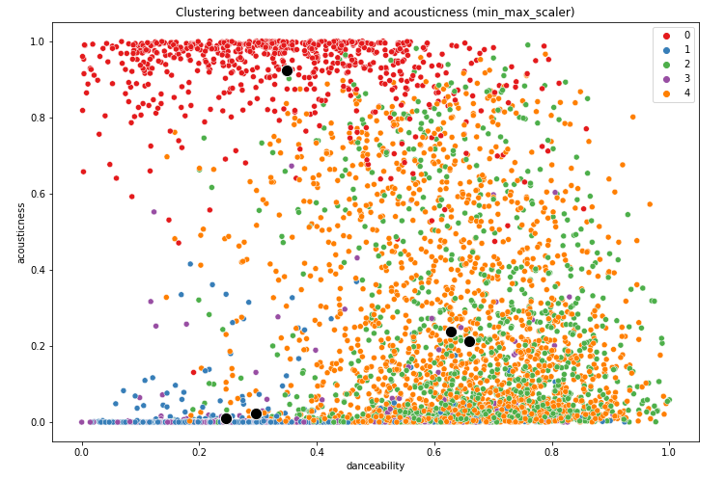
Correlation between danceability and other features

Slide 9
Cluster 4
Loud
Instrumental
Acoustic
Orchestra
Symphonies
Name of playlist: “Best of Instrumental Music”

Slide 10


Pro’s of K-Means
Con’s of K-Means
Relatively simple to implement.
Scales to large data sets.
Can warm-start the positions of centroids.
Easily adapts to new examples.
Choosing the k values manually is a tough job.
Being dependent on initial values.
It is sensitive to the outliers.
As the number of dimensions increases its scalability decreases.
Overlapping the clusters.

Slide 11
Conclusion
Spotify’s audio features is a good way to describe a song in numbers, but not close to human understanding of the song
K-Means is not the best way to create playlists
Add more audio features: like pitch, melody, frequency, ….
Explore different methods to create playlist
Recommendation

